Slide 1
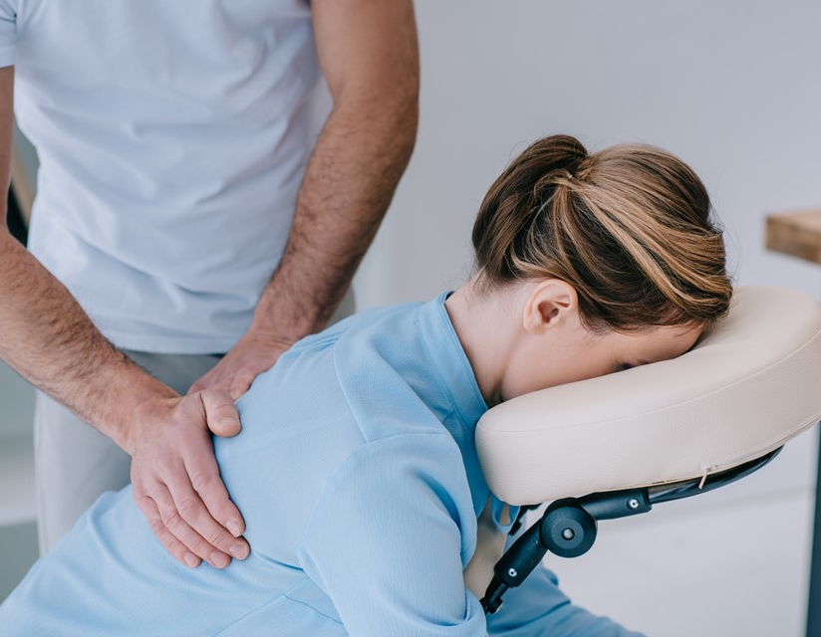
CMIT Solutions helps XpresSpa Group expand footprint
Agile IT and Security Solutions Combined with Multi-Location Support Enable Growth
Business Type: Multi-location, healthcare and wellness
Notes:
https://www.istockphoto.com/photo/generic-hotel-building-gm157642990-14191385https://www.istockphoto.com/photo/generic-hotel-building-gm157642990-14191385

Slide 2
About XpresSpa
XpresSpa Group, Inc. (the “Company” or “XpresSpa”), a leading global health and wellness company, is an example of how to adapt and thrive.
The XpresSpa® brand offers wellness services and related products in 35 stores located in 11 airports across the US and has several international locations.
End points
With COVID-19 and social distancing protocols enacted, the Company added XpresCheck® operations to many airport locations to provide Covid-19 screening and diagnostic testing services.
Store locations nationwide
In response to post-COVID growth in travel, the Company has launched Treat™, its travel health and wellness brand that provides on-demand access to healthcare through technology and personalized services.
Airports serviced in the U.S.

Slide 3
Effective IT Support and adjusting IT strategies to accommodate new locations and changing business needs are essential in any company’s ability to continually adapt. With its changing business model, XpresSpa Group, Inc. knew it needed an IT support partner to help increase the efficiency of their business.
Over a period of several months, CMIT Solutions’ team worked closely with David Kohel, Chief Technology Officer at XpresSpa Group, Inc. and its IT team to develop a comprehensive strategy. Together, they developed a roadmap of IT and cybersecurity services that CMIT Solutions could provide to XpresSpa locations.
CMIT Solutions was able to provide effective IT support for XpresSpa across the nation. As there are local CMIT Solutions locations near all XpresSpa airport locations, CMIT Solutions was able to combine remote IT support and local on-site resources whenever needed. Additionally, CMIT Solutions was able to increase XpresSpa’s business ability by migrating their server infrastructure to the cloud, smoothing business operations.
“Working with CMIT Solutions has been a phenomenal experience. The team has been extremely helpful and continues to prove that they are reliable IT sources to aid our growing business. We were able to quickly transition to a more modern infrastructure and technology footprint, and even enable processes like automation, which helped us immensely.”
— David Kohel, Chief Technology Officer at XpresSpa Group
CMIT Solutions managed XpresSpa’s hundreds of digital devices to ensure their POS systems and applications ran smoothly. They also created the infrastructure that allowed XpresSpa to seamlessly onboard new users and keep all existing users up to date by using Microsoft InTune. After establishing a connection to all devices, CMIT Solutions implemented multiple layers of security for the company, including anti-virus, email security, and phishing protection, as well as Security Intrusion Event Monitoring.
The CMIT Solutions team has worked side by side with XpresSpa for six months, and along with the above achievements, has also assisted in the rollout of five new locations, adapted several repurposed locations, and responded to XpresSpa’s evolving needs. An agile business requires an agile IT partner, and CMIT Solutions I proud to be just that.

Slide 4
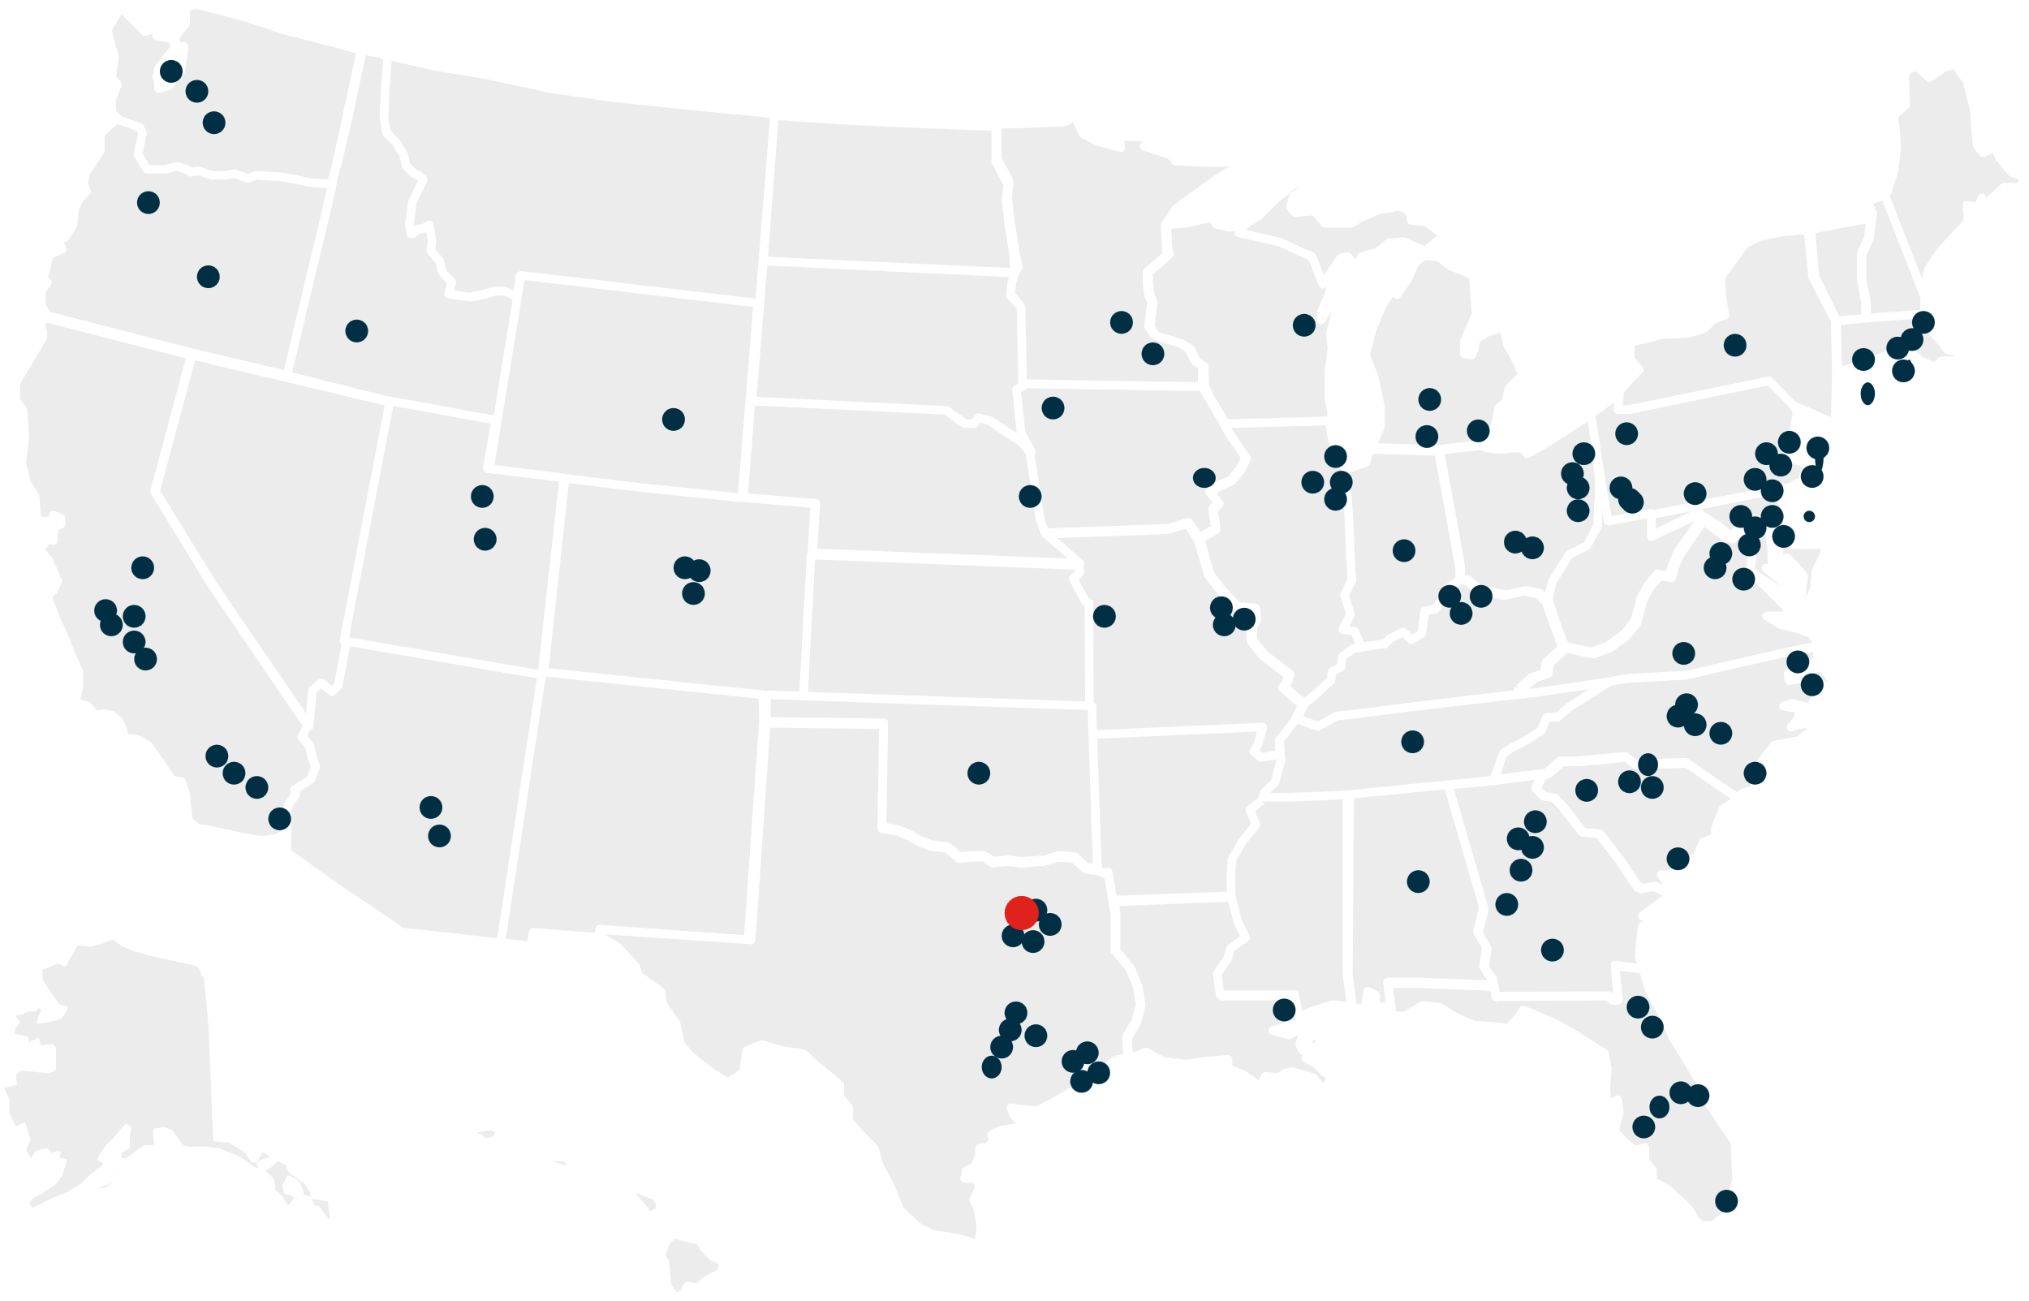
Scalable IT Solutions for Your Expanding Network
Managing IT for multi-location businesses comes with unique challenges. With a focus on consistent support, scalable growth, and localized service across the nation, we ensure your IT infrastructure is tailored to meet your needs.
From maintaining consistent support across all sites to ensuring seamless network connectivity, scalability, and robust cybersecurity, the complexity can be overwhelming. That’s where CMIT Solutions steps in.
Unwavering IT support across locations.
Effortless scalability for growth
Ensure every site operates smoothly with tailored, standardized IT services that eliminate downtime and enhance productivity.
Stay ahead of expansion demands with adaptable IT systems designed to grow seamlessly alongside your business.
Streamlined network connectivity
Fortified cybersecurity solutions
Achieve flawless communication and data sharing through secure, unified network solutions across all locations.
Protect your customers' or patients’ sensitive data with proactive security measures, ensuring compliance within your industry, such as PCI, WISP, HIPAA, and more.

Slide 5
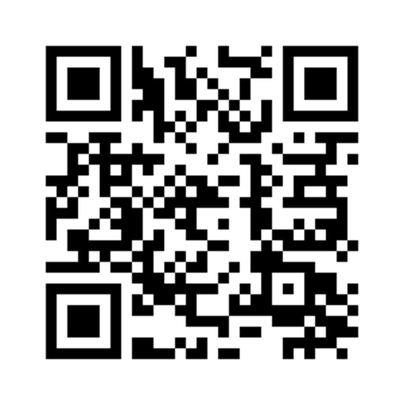
Service Highlights
IT Support
Cybersecurity
Compliance
Productivity Applications
Cloud Services
IT Guidance
IT Procurement
Network Management
Data Backup
Unified Communications
CMIT Packages
CORE
PRO
ULTRA
Remote Monitoring and Management
Remote Access
Anti-Virus
Patch Management
Asset Lifecycle Reporting
Email Security and Archive
M365 Cloud to Cloud Backup
Phishing Protection
Endpoint Detection and Response
DNS Filtering
24/7/365 Help Desk
Unlimited Remote Remediation
SIEM/SOC/MDR Cybersecurity
Security Awareness Training
Domain Monitoring
Dark Web Monitoring
Email Incident Response
Unlimited Onsite Remediation
Contact us to learn more about our services and fees:
https://cmitsolutions.com/contact-us/
Notes:
Assist with
Project management for various system upgrades – HSIA (High speed internet access) upgrades (Guest wireless systems), property management, point of sale, installation for new built hotels (6 a year), a lot of them are construction companies. Real estate development
Design the network and infrastructures of the IT in hotels
vCIO - Virtual CIO – If they don’t have IT on staff, talk about what we are doing for 2024 for cybersecurity
Transition one hotels to another
People are not buying and selling hotels as much post covid
Project Management
Professional Service
vCIO
PCI Compliance
Cybersecurity
Data Backup
IT support
IT Procurement

